Slide 1
4. Conditionals and Loops
1.1–1.2
Notes:
Learning Objectives
(4.1a) Write program code to satisfy program specifications using expressions, conditional statements, and iterative statements.
(4.1b) Determine how many times a program segment will execute.
(4.1c) Determine if two or more code segments result with the same outcomes.
(4.1d) Describe the behavior of code segments involving control structures.
(4.1e) Describe why a given code segment does not work as intended.
(4.1f) Determine the most appropriate selection/control control structures for a particular specification.
(4.1g) Implement and trace code involving compound assignment idioms within loops (i++).
(4.1h) Implement and trace code involving breakand continue
(4.1i) Recognize conditions that would result in an infinite loop scenario.
(4.1j) Describe the process and result of nesting control structures.
(4.1k) Trace program segments involving nested control structures.
(4.1l) Write program code involving nested control structures.
(4.1m) Create appropriate test cases for ifstatements and test ifstatements in a comprehensive manner.
(4.1n) Identify the scope of variables within a program involving loops and conditionals.
(4.1o) Count the number of operations executed in program or program segment.

Slide 2
4. Conditionals & Loops
Conditionals: the if statement
Loops: the while statement
An alternative: the for loop
Nesting
Debugging
adopted and modified from Slides by Sedgewick and Wayne

Slide 3

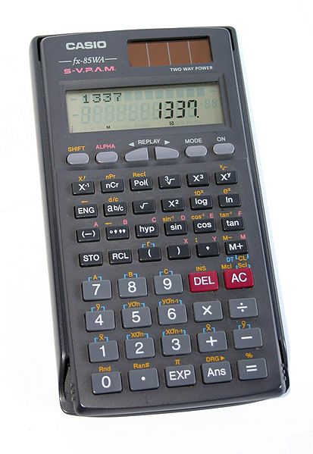
Context: basic building blocks for programming
any program you might want to write
objects
functions and modules
graphics, sound, and image I/O
arrays
conditionals and loops
conditionals and loops
Math
text I/O
primitive data types
assignment statements
This lecture:
to infinity and beyond!
Previous lecture:
equivalent to a calculator

Slide 4
Conditionals and Loops
Control flow
The sequence of statements that are actually executed in a program.
Conditionals and loops enable us to choreograph control flow.
statement 1
true
boolean 1
false
statement 2
statement 1
boolean 2
true
statement 2
statement 3
false
statement 4
statement 3
straight-line control flow
[ previous lecture ]
control flow with conditionals and a loop
[this lecture]
Notes:
straight-line programs: akin to calculator

Slide 5
The if statement
Execute certain statements depending on the values of certain variables.
Evaluate a boolean expression.
If true, execute a statement.
The else option: If false, execute a different statement.
Example: if (x < 0) x = -x;
Example: if (x > y) max = x;
else max = y;
true
x < 0 ?
false
true
x > y ?
false
x = -x;
max = x;
max = y;
Replaces x with the absolute value of x
Computes the maximum of x and y

Slide 6

Example of if statement use: simulate a coin flip
public class Flip
{
public static void main(String[] args)
{
if (Math.random() < 0.5)
System.out.println("Heads");
else
System.out.println("Tails");
}
}
% java Flip
Heads
% java Flip
Heads
% java Flip
Tails
% java Flip
Heads
Notes:
Note difference between print(year) and println("leap year");

Slide 7
Example of if statement use
: 2-sort
Q. What does this program do?
public class TwoSort
{
public static void main(String[] args)
{
int a = Integer.parseInt(args[0]);
int b = Integer.parseInt(args[1]);
if (b < a) {
int t = a;
a = b;
b = t;
}
System.out.println(a);
System.out.println(b);
}
}
% java TwoSort 1234 99
99
1234
% java TwoSort 99 1234
99
1234
alternatives for if and else
can be a sequence of
statements, enclosed in braces
A. Reads two integers from the command line, then prints them out in numerical order.
Notes:
Note difference between print(year) and println("leap year");

Slide 8
Pop quiz on if statements
Q. Add code to this program that puts a, b, and c in numerical order.
public class ThreeSort
{
public static void main(String[] args)
{
int a = Integer.parseInt(args[0]);
int b = Integer.parseInt(args[1]);
int c = Integer.parseInt(args[2]);
System.out.println(a);
System.out.println(b);
System.out.println(c);
}
}
% java ThreeSort 1234 99 1
1
99
1234
% java ThreeSort 99 1 1234
1
99
1234
Notes:
Note difference between print(year) and println("leap year");

Slide 9
Pop quiz on if statements
Q. Add code to this program that puts a, b, and c in numerical order.
public class ThreeSort
{
public static void main(String[] args)
{
int a = Integer.parseInt(args[0]);
int b = Integer.parseInt(args[1]);
int c = Integer.parseInt(args[2]);
if (b < a)
{ int t = a; a = b; b = t; }
if (c < a)
{ int t = a; a = c; c = t; }
if (c < b)
{ int t = b; b = c; c = t; }
System.out.println(a);
System.out.println(b);
System.out.println(c);
}
}
% java ThreeSort 1234 99 1
1
99
1234
% java ThreeSort 99 1 1234
1
99
1234
A.
makes a smaller
than b
makes a smaller
than both b and c
makes b smaller
than c
Notes:
Note difference between print(year) and println("leap year");

Slide 10
Example of if statement use: error checks
public class IntOps
{
public static void main(String[] args)
{
int a = Integer.parseInt(args[0]);
int b = Integer.parseInt(args[1]);
int sum = a + b;
int prod = a * b;
System.out.println(a + " + " + b + " = " + sum);
System.out.println(a + " * " + b + " = " + prod);
if (b == 0) System.out.println("Division by zero");
else System.out.println(a + " / " + b + " = " + a / b);
if (b == 0) System.out.println("Division by zero");
else System.out.println(a + " % " + b + " = " + a % b);
}
}
% java IntOps 5 2
5 + 2 = 7
5 * 2 = 10
5 / 2 = 2
5 % 2 = 1
% java IntOps 5 0
5 + 0 = 5
5 * 0 = 0
Division by zero
Division by zero
Good programming practice. Use conditionals to check for and avoid runtime errors.

Slide 11
4. Conditionals & Loops
Conditionals: the if statement
Loops: the while statement
An alternative: the for loop
Nesting
Debugging
Notes:
A good loop:
“Powell Speaks, Trump Tweets, China Reacts, Markets Freak. Repeat”
- https://www.bloomberg.com/businessweek

Slide 12
The while loop
Execute certain statements repeatedly until certain conditions are met.
Evaluate a boolean expression.
If true, execute a sequence of statements.
Repeat.
i = 0;
v = 1;
Example:
int i = 0;
int v = 1;
while (i <= n)
{
System.out.println(v);
i = i + 1;
v = 2 * v;
}
MUST HAVE: initialization, test, update
i <= n ?
false
true
System.out.println(v);
i = i + 1;
v = 2 * v;
Prints the powers of two from 2⁰ to 2^{n} .
[stay tuned for a trace]

Slide 13
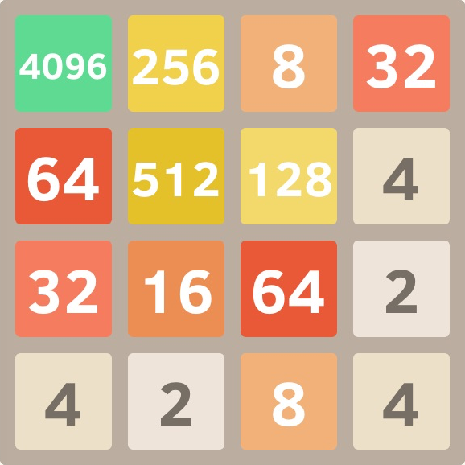
Example of while loop use: print powers of two
LO 4.1a
A trace is a table of variable values after each statement.
public class PowersOfTwo
{
public static void main(String[] args)
{
int n = Integer.parseInt(args[0]);
int i = 0;
int v = 1;
while (i <= n)
{
System.out.println(v);
i = i + 1;
v = 2 * v;
}
}
}
i | v | i <= n
0 | 1 | true
1 | 2 | true
2 | 4 | true
3 | 8 | true
4 | 16 | true
5 | 32 | true
6 | 64 | true
7 | 128 | false
% java PowersOfTwo 6
1
2
4
8
16
32
64
Prints the powers of two from 2⁰ to 2^{n} .
Notes:
(4.1a) Write program code to satisfy program specifications using expressions, conditional statements, and iterative statements.

Slide 14
powers of two : counting operations
LO 4.1b
Counting operations is a good way to know how well your program works.
public class PowersOfTwo
{
public static void main(String[] args)
{
int n = Integer.parseInt(args[0]);
int i = 0;
int v = 1;
while (i <= n)
{
System.out.println(v);
i = i + 1;
v = 2 * v;
}
}
}
1 initialize operation
1 initialize operation
1 initialize operation
Loop body is executed for i = 0..n (n+1 times)
Loop condition checked for i= 0..n+1 (n+2 times)
1 print operation
1 increment/assignment operation
Total operations
3 + (n+2) + 3 (n+1)
1 multiply/assignment operation
Prints the powers of two from 2⁰ to 2^{n} .
Notes:
(4.1b) Determine how many times a program segment will execute.

Slide 15
Pop quiz on while loops
LO 4.1e
Q. Anything wrong with the following code?
public class PQwhile
{
public static void main(String[] args)
{
int n = Integer.parseInt(args[0]);
int i = 0;
int v = 1;
while (i <= n)
System.out.println(v);
i = i + 1;
v = 2 * v;
}
}
Notes:
(4.1e) Describe why a given code segment does not work as intended.

Slide 16

Pop quiz on while loops
LO 4.1ei
Q. Anything wrong with the following code?
public class PQwhile
{
public static void main(String[] args)
{
int n = Integer.parseInt(args[0]);
int i = 0;
int v = 1;
while (i <= n)
System.out.println(v);
i = i + 1;
v = 2 * v;
}
}
Q. What does it do (without the braces)?
A. Goes into an infinite loop.
% java PQwhile 6
1
1
1
1
1
1
1
1
1
1
1
{
challenge: figure out
how to stop it
on your computer
}
A. Yes! Needs braces.
Notes:
(4.1e) Describe why a given code segment does not work as intended.
(4.1i) Recognize conditions that would result in an infinite loop scenario.

Slide 17
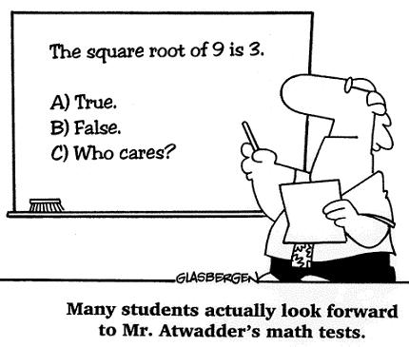
Example of while loop use: implement Math.sqrt()
Goal. Implement square root function.
% java Sqrt 60481729.0
7777.0
% java Sqrt 2.0
1.4142136
Newton-Raphson method to compute √c
Initialize t0 = c.
Repeat until ti = c/ti (up to desired precision): Set ti+1 to be the average of ti and c / ti.
if t = c/t then t² = c
i | ti | 2/ti | average
0 | 2 | 1 | 1.5
1 | 1.5 | 1.3333333 | 1.4166667
2 | 1.4166667 | 1.4117647 | 1.4142157
3 | 1.4142157 | 1.4142114 | 1.4142136
4 | 1.4142136 | 1.4142136
computing the square root of 2 to seven places

Slide 18

Example of while loop use: implement Math.sqrt()
Newton-Raphson method to compute √c
Initialize t0 = c.
Repeat until ti = c/ti (up to desired precision): Set ti+1 to be the average of ti and c / ti.
Scientists studied computation well before the onset of the computer.
Isaac Newton
1642-1727
public class Sqrt
{
public static void main(String[] args)
{
double EPS = 1E-15;
double c = Double.parseDouble(args[0]);
double t = c;
while (Math.abs(t - c/t) > t*EPS)
t = (c/t + t) / 2.0;
System.out.println(t);
}
}
% java Sqrt 60481729.0
7777.0
% java Sqrt 2.0
1.414213562373095
error tolerance (15 places)

Slide 19
Newton-Raphson method
Explanation (some math omitted)
Goal: find root of function f(x) (value of x for which f(x) = 0).
Start with estimate t₀.
Draw line tangent to curve at x = t_{i} .
Set t_{i+1} to be x-coordinate where line hits x-axis.
Repeat until desired precision.
use f(x) = x² − c for √c
y = f(x)
root: f(x) = 0
ti+3
ti+2
ti+1
ti
Notes:
Applications and extensions.
Find roots of a differentiable function (of one or several variables).
Optimize a twice differentiable function. (check where derivative is zero)

Slide 20
4. Conditionals & Loops
Conditionals: the if statement
Loops: the while statement
An alternative: the for loop
Nesting
Debugging

Slide 21


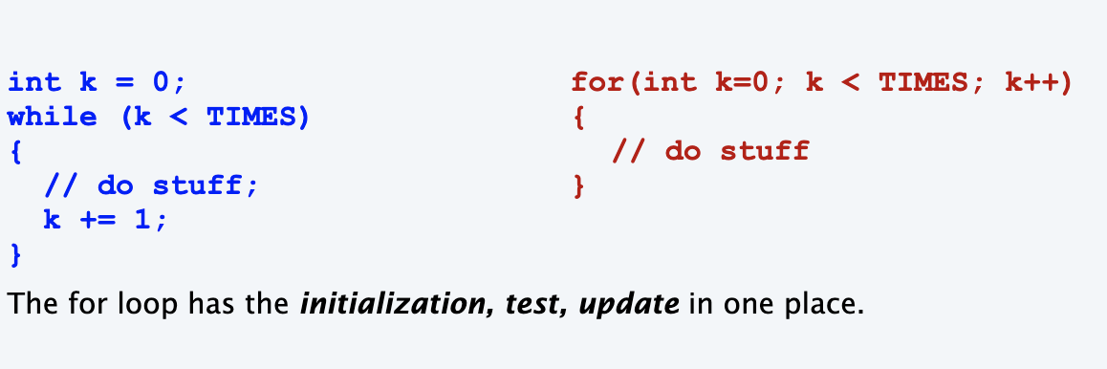

Slide 22
The for loop
LO 4.1c
An alternative repetition structure.
Evaluate an initialization statement.
Evaluate a boolean expression.
If true, execute a sequence of statements, then execute an increment statement.
Repeat.
Why? Can provide code that is more compact and understandable.
Example:
int v = 1;
for ( int i = 0; i <= n; i++ )
{
System.out.println( i + " " + v );
v = 2*v;
}
Every for loop has an equivalent while loop:
int v = 1;
int i = 0;
while ( i <= n )
{
System.out.println( i + " " + v );
v = 2*v;
i++;
}
initialization statement
boolean expression
increment statement
Prints the powers of two from 2⁰ to 2^{n}
Notes:
(4.1c) Determine if two or more code segments result with the same outcomes.

Slide 23
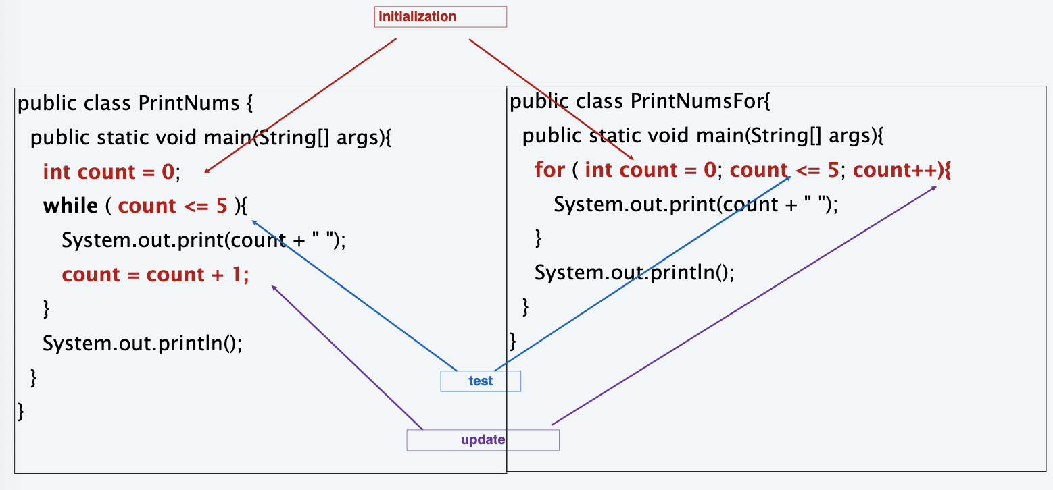
Example: Java program (while vs. for)

Slide 24
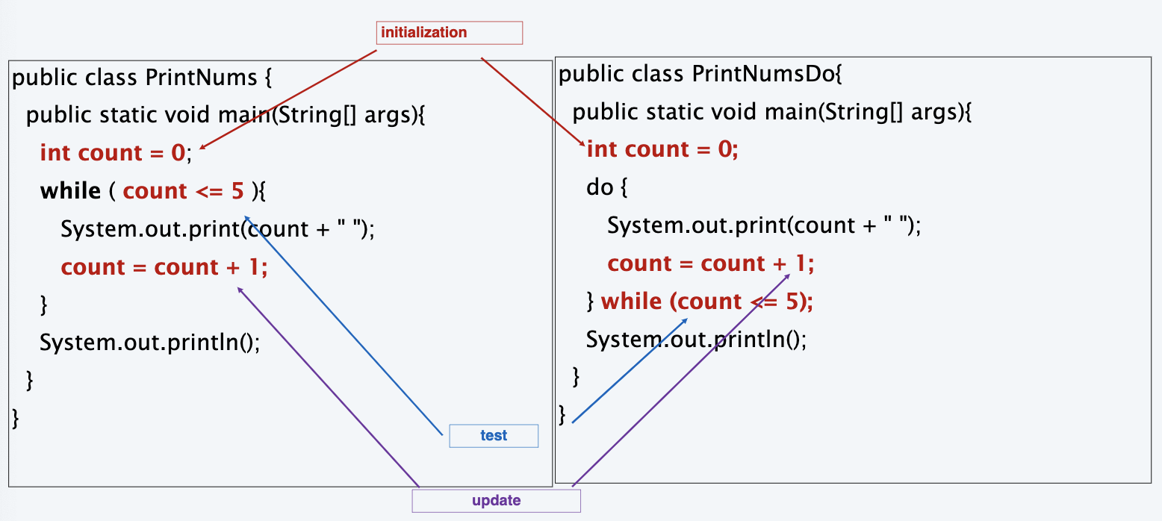
Example: Java program (while vs. do-while)

Slide 25
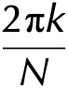
Examples of for loop use
LO 4.1d
int sum = 0;
for (int i = 1; i <= N; i++)
sum += i;
System.out.println(sum);
sum | i
1 | 1
3 | 2
6 | 3
10 | 4
trace at end of loop for N = 4
Compute sum (1 + 2 + 3 + . . . + N)
product | i
1 | 1
2 | 2
6 | 3
24 | 4
long product = 1;
for (int i = 1; i <= N; i++)
product *= i;
System.out.println(product);
k
0 | 0
1 | 1.57079632...
2 | 3.14159265...
3 | 4.71238898...
4 | 6.28318530...
Compute N! = 1 * 2 * 3 * . . . * N
for (int k = 0; k <= N; k++)
System.out.println(k + " " + 2*Math.PI*k/N);
Print a table of function values
v
2
4
8
16
int v = 1;
while (v <= N/2)
v = 2*v;
System.out.println(v);
trace at end of loop for N = 23
Print largest power of 2 less than or equal to N
Notes:
(4.1d) Describe the behavior of code segments involving control structures.

Slide 26
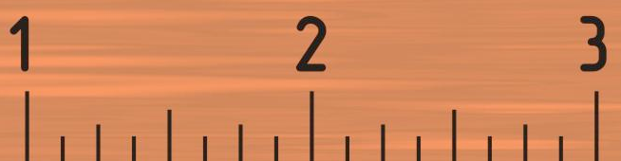
Example of for loop use: subdivisions of a ruler
Create subdivisions of a ruler to 1/N inches.
Initialize ruler to one space.
For each value i from 1 to N: sandwich i between two copies of ruler.
1 2 1 3 1 2 1 4 1 2 1 3 1 2 1
i | ruler
1 | " 1 "
2 | " 1 2 1 "
3 | " 1 2 1 3 1 2 1 "
4 | " 1 2 1 3 1 2 1 4 1 2 1 3 1 2 1 "
public class Ruler
{
public static void main(String[] args)
{
int N = Integer.parseInt(args[0]);
String ruler = " ";
for (int i = 1; i <= N; i++)
ruler = ruler + i + ruler;
System.out.println(ruler);
}
}
End-of-loop trace
java Ruler 4
1 2 1 3 1 2 1 4 1 2 1 3 1 2 1
% java Ruler 100
Exception in thread "main"
java.lang.OutOfMemoryError
Note: Small program can produce huge amount of output.
2¹⁰⁰ − 1 integers in output (!)
Notes:
good style to declare loop iteration variable in initialization statement.
Example of automatic type conversion from integer to string.

Slide 27
Know when to use each type of loop!
for loop
you know exactly how many times loop is to be executed
while loop
loop may be executing zero times
do..while loop
loop must execute at least once

Slide 28
Scope of for loop variables
If a variable is declared in the for loop header, its scope extends to the end of the for loop.
for(int x = 1; x <= n; x++) {
// x can be accessed here
}
// x is no longer defined.

Slide 29
Scope of for loop variables
If a variable is declared in the for loop header, its scope extends to the end of the forloop.
However, can declare before the for loop and initialize in the for loop.
int x;
for(x = 1; x <= n; x++){
// x can be accessed here
}
// x is still in scope here

Slide 30
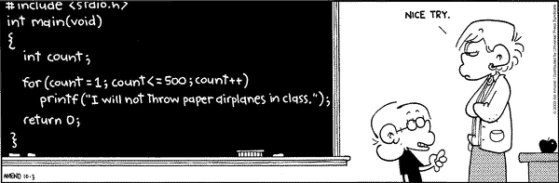
Copyright 2004, FoxTrot by Bill Amend
www.ucomics.com/foxtrot/2003/10/03

Slide 31
Pop quiz on for loops
LO 4.1d
Q. What does the following program print?
public class PQfor
{
public static void main(String[] args)
{
int f = 0, g = 1;
for (int i = 0; i <= 10; i++) { System.out.println(f);
f = f + g;
g = f - g;
}
}
}
Notes:
(4.1d) Describe the behavior of code segments involving control structures.

Slide 32
Pop quiz on for loops
Q. What does the following program print?
public class PQfor
{
public static void main(String[] args)
{
int f = 0, g = 1;
for (int i = 0; i <= 10; i++) { System.out.println(f);
f = f + g;
g = f - g;
}
}
}
Beginning-of-loop trace
A.
i | f | g
0 | 0 | 1
1 | 1 | 0
2 | 1 | 1
3 | 2 | 1
4 | 3 | 2
5 | 5 | 3
6 | 8 | 5
7 | 13 | 8
8 | 21 | 13
9 | 34 | 21
10 | 55 | 34
Printed values of f

Slide 33
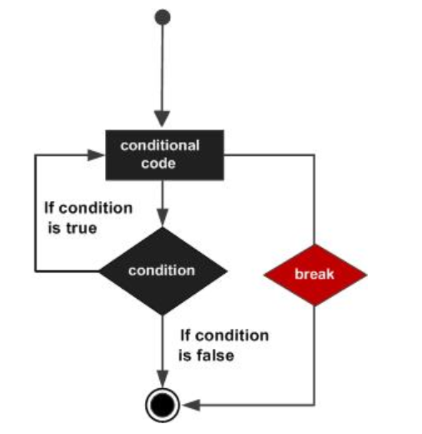
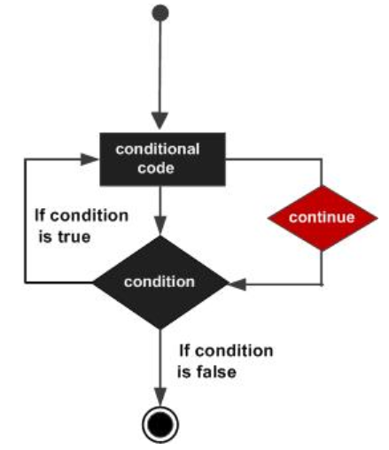
Break and continue
LO 4.1h
break: exit the loop
continue: skip to end of the loop and continue to the next iteration
for (int i=0; I < n ; i++) {
if ( i == 11)
continue;
System.out.println(i);
}
for (int i=0; I < n ; i++) {
if ( i == 11)
break;
System.out.println(i);
}
break is executed when i is 11 which forces the end of the loop (exit the loop)
Loop skips printing 11
Notes:
(4.1h) Implement and trace code involving break and continue

Slide 34
4. Conditionals & Loops
Conditionals: the if statement
Loops: the while statement
An alternative: the for loop
Nesting
Debugging

Slide 35

Nesting conditionals and loops
LO 4.1j
Nesting
Any “statement” within a conditional or loop may itself be a conditional or a loop statement.
Enables complex control flows.
Adds to challenge of debugging.
Example:
for (int t = 0; t < trials; t++)
{
int cash = stake;
while (cash > 0 && cash < goal)
if (Math.random() < 0.5) cash++;
else cash--;
if (cash == goal) wins++;
}
if-else statement
within a while loop
within a for loop
[ Stay tuned for an explanation of this code. ]
Notes:
(4.1j) Describe the process and result of nesting control structures.

Slide 36
Buggy code
LO 4.1i
Conditions
What conditions in the code below could result .
Example:
int i = 10;
while ( i > 1) {
System.out.println(i);
i++;
}
The value of i is always greater than 1
Notes:
(4.1i) Recognize conditions that would result in an infinite loop scenario.

Slide 37
Example of nesting conditionals: Tax rate calculation
Goal. Given income, calculate proper tax rate.
income | rate
0 – $47,450 | 22%
$47,450 – $114,649 | 25%
$114,650 – $174,699 | 28%
$174,700 – $311,949 | 33%
$311,950 + | 35%
if (income < 47450) rate = 0.22;
else
{
if (income < 114650) rate = 0.25;
else
{
if (income < 174700) rate = 0.28;
else
{
if (income < 311950) rate = 0.33;
else rate = 0.35;
}
}
}
if statement
within an if statement
if statement
within an if statement
within an if statement
if statement
within an if statement
within an if statement
within an if statement
Notes:
This program is worthy of careful study.
Conditional within a while loop within a for loop.
Inner loop uses && to continue as long as gambler is not broke and didn't reach goal

Slide 38
Pop quiz on nested if statements
LO 4.1e
Q. Anything wrong with the following code?
public class PQif
{
public static void main(String[] args)
{
double income = Double.parseDouble(args[0]);
double rate = 0.35;
if (income < 47450) rate = 0.22;
if (income < 114650) rate = 0.25;
if (income < 174700) rate = 0.28;
if (income < 311950) rate = 0.33;
System.out.println(rate);
}
}
Notes:
(4.1e) Describe why a given code segment does not work as intended.

Slide 39
Pop quiz on nested if statements
Q. Anything wrong with the following code?
public class PQif
{
public static void main(String[] args)
{
double income = Double.parseDouble(args[0]);
double rate = 0.35;
if (income < 47450) rate = 0.22;
if (income < 114650) rate = 0.25;
if (income < 174700) rate = 0.28;
if (income < 311950) rate = 0.33;
System.out.println(rate);
}
}
Note. Braces are not needed in this case, but BE CAREFUL when nesting if-else statements because of potential ambiguity.
else
else
else
if (income < 311950) rate = 0.33;
else rate = 0.35;
A. Yes! Need else clauses. Without them, code is equivalent to:

Slide 40

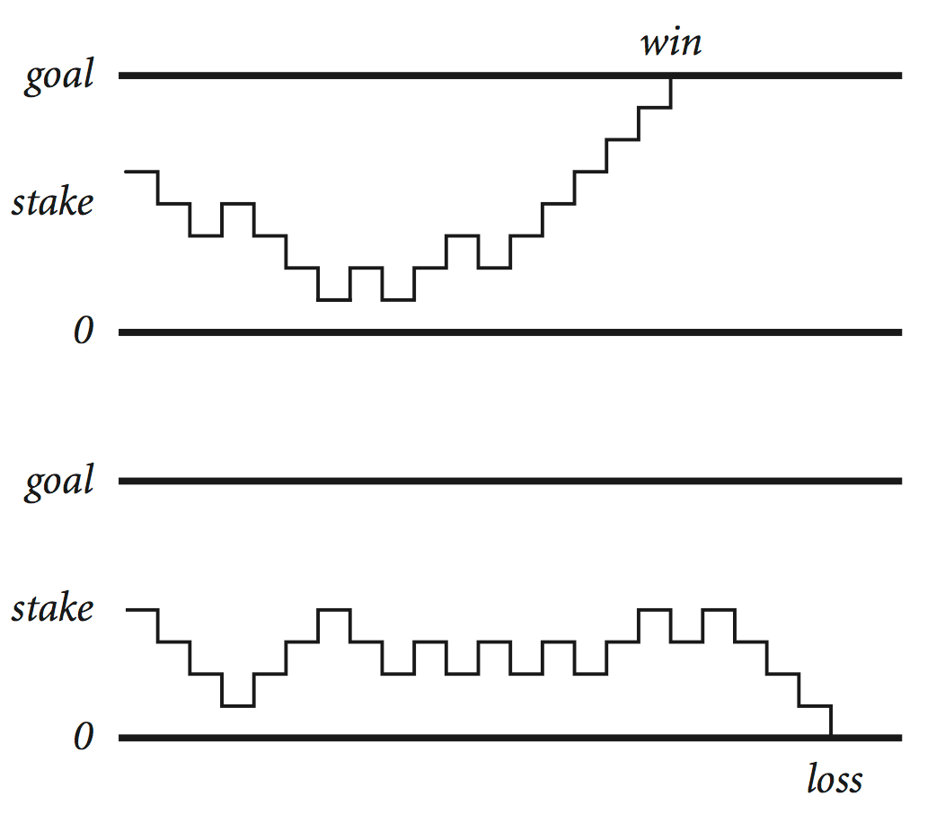
Gambler's ruin problem
A gambler starts with $stake and places $1 fair bets.
Outcome 1 (loss): Gambler goes broke with $0.
Outcome 2 (win): Gambler reaches $goal.
One approach: Monte Carlo simulation.
Use a simulated coin flip.
Repeat and compute statistics.
Q. What are the chances of winning?
Q. How many bets until win or loss?
Notes:
discrete analog of Brownian motion (applications to stock market – Black-Scholes, behavior of atomic particles predicted by quantum physics, dispersion of ink flowing in water)
Simulations of this sort are widely used in economics, science and engineering

Slide 41
Example of nesting conditionals and loops: Simulate gambler's ruin
public class Gambler
{
public static void main(String[] args)
{
int stake = Integer.parseInt(args[0]);
int goal = Integer.parseInt(args[1]);
int trials = Integer.parseInt(args[2]);
int wins = 0;
for (int t = 0; t < trials; t++)
{
int cash = stake;
while (cash > 0 && cash < goal)
{
if (Math.random() < 0.5) cash++;
else cash--;
}
if (t == goal) wins++;
}
System.out.println(wins + " wins of " + trials);
}
}
Gambler's ruin simulation
Get command-line arguments.
Run all the experiments.
Run one experiment.
Make one bet.
If goal met, count the win.
Print #wins and # trials.
for loop
while loop
within a for loop
if statement
within a while loop
within a for loop
% java Gambler 5 25 1000
191 wins of 1000
Notes:
This program is worthy of careful study.
Conditional within a while loop within a for loop.
Inner loop uses && to continue as long as gambler is not broke and didn't reach goal

Slide 42



Digression: simulation and analysis
Facts (known via mathematical analysis for centuries)
Probability of winning = stake ÷ goal.
Expected number of bets = stake × desired gain.
Early scientists were fascinated by the study of games of chance.
Christiaan Huygens
1629-1695
Example
20% chance of turning $500 into $2500.
Expect to make 1 million $1 bets.
stake
goal
trials
% java Gambler 5 25 1000
191 wins of 1000
% java Gambler 5 25 1000
203 wins of 1000
% java Gambler 500 2500 1000
197 wins of 1000
500/2500 = 20%
500*(2500 - 500) = 1,000,000
uses about 1 billion coin flips
Remarks
Computer simulation can help validate mathematical analysis.
For this problem, mathematical analysis is simpler (if you know the math).
For more complicated variants, computer simulation may be the best plan of attack.

Slide 43
Pop quiz on selecting appropriate control structures
LO 4.1f
Q. In each of these cases, find an appropriate control structure
Given 3 integers, find the max value
Given n integers, find the max value
Print a n x n grid of integers
nested if statements
nested while-if statements
nested while-while (or for-for) statements
Notes:
(4.1f) Determine the most appropriate selection/control control structures for a particular specification.

Slide 44
4. Conditionals & Loops
Conditionals: the if statement
Loops: the while statement
An alternative: the for loop
Nesting
Debugging

Slide 45






Debugging
is 99% of program development in any programming language, even for experts.
Bug: A mistake in a program.
Debugging: The process of eliminating bugs.
EDIT
You will make many mistakes as you write programs. It's normal.
COMPILE
RUN
“ As soon as we started programming, we found out to our surprise that it wasn't as easy to get programs right as we had thought. I can remember the exact instant when I realized that a large part of my life from then on was going to be spent in finding mistakes in my own programs. ”
− Maurice Wilkes
Impossible ideal: "Please compile, execute, and debug my program."
Why is this impossible? Stay tuned.
Bottom line: Programming is primarily a process of finding and fixing mistakes.

Slide 46

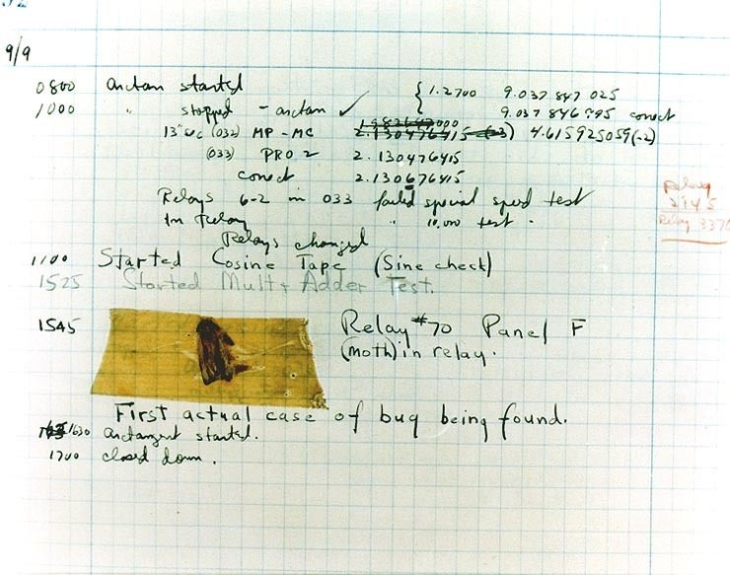
Debugging
is 99% of program development in any programming language, even for experts.
Grace Hopper
https://www.nationalgeographic.org/thisday/sep9/worlds-first-computer-bug/

Slide 47

Debugging
is challenging because conditionals and loops dramatically increase the number of possible outcomes.
program structure | no loops | n conditionals | 1 loop
number of possible execution sequences | 1 | 2^{n} | no limit
Most programs contain numerous conditionals and loops, with nesting.
Good news. Conditionals and loops provide structure that helps us understand our programs.
Old and low-level languages have a goto statement that provides arbitrary structure. Eliminating gotos was controversial until Edsgar Dijkstra published the famous note "Goto considered harmful" in 1968.
“ The quality of programmers is a decreasing function of the number of goto statements in the programs they produce. ”
− Edsgar Dijkstra

Slide 48
Debugging a program: a running example
LO 4.1k
Problem: Factor a large integer n.
Application: Cryptography.
3,757,208 = 2 × 2 × 2 × 7 × 13 × 13 × 397
98 = 2 × 7× 7
17 = 17
Surprising fact: Security of internet commerce depends on difficulty of factoring large integers.
11,111,111,111,111,111 = 2,071,723 × 5,363,222,357
public class Factors
{
public static void main(String[] args)
{
long n = Long.parseLong(args[0])
for (i = 0; i < n; i++)
{
while (n % i == 0)
System.out.print(i + " ")
n = n / i
}
}
}
Method
Consider each integer i less than n
While i divides n evenly Print i (it is a factor of n). Replace n with n/i .
Rationale:
1. Any factor of n/i is a factor of n.
2. i may be a factor of n/i.
This program has bugs!
Notes:
(4.1k) Trace program segments involving nested control structures.

Slide 49

Debugging a program: syntax errors
LO 4.1k
Is your program a legal Java program?
Java compiler can help you find out.
Find the first compiler error (if any).
Repeat.
Result: An executable Factors.class file
EDIT
COMPILE
Trying to tell a computer what to do
% javac Factors.java
Factors.java:5: ';' expected
long n = Long.parseLong(args[0])
^
...
public class Factors
{
public static void main(String[] args)
{
long n = Long.parseLong(args[0])
for ( i = 0; i < n; i++)
{
while (n % i == 0)
System.out.print(i + " ")
n = n / i
}
}
}
need to declare
type of i
;
% javac Factors.java
Factors.java:6: cannot find symbol
symbol : variable i
location: class FactorsX
for ( i = 0; i < n; i++)
^
...
int
;
;
need terminating semicolons
% javac Factors.java
%
This legal program still has bugs!

Slide 50
Debugging a program: runtime and semantic errors
Does your legal Java program do what you want it to do?
You need to run it to find out.
Find the first runtime error (if any).
Fix and repeat.
EDIT
COMPILE
RUN
% javac Factors.java
% java Factors
Exception in thread "main" java.lang.ArrayIndexOutOfBoundsException: 0
at Factors.main(Factors.java:5)
need to start at 2
since 0 and 1
are not factors
public class Factors
{
public static void main(String[] args)
{
long n = Long.parseLong(args[0]);
for ( int i = 0; i < n; i++)
{
while (n % i == 0)
System.out.print(i + " ");
n = n / i;
}
}
}
oops, need argument
% java Factors 98
Exception in thread "main" java.lang.ArithmeticException: / by zero
at Factors.main(Factors.java:8)
you will see this message!
2
{
}
% java Factors 98
2 2 2 2 2 2 2 2 2 2 2 2 2 2 2 2 2 2 2 2 2 2 2 2 2 2 2 2 2 2 2 2 2 2 2 2 2 2 2 2 2 2 2 2 2 2
need braces
This working program still has bugs!
% java Factors 98
2 7 7%
✓
98 = 2 × 7× 7

Slide 51
Debugging a program: testing
Does your legal Java program always do what you want it to do?
You need to test on many types of inputs it to find out.
Add trace code to find the first error.
Fix the error.
Repeat.
public class Factors
{
public static void main(String[] args)
{
long n = Long.parseLong(args[0]);
for ( int i = 2; i < n; i++)
{
while (n % i == 0)
{
System.out.print(i + " ");
n = n / i;
}
}
}
}
% java Factors 98
2 7 7%
need newline
% javac Factors.java
% java Factors 5
TRACE 2 5
TRACE 3 5
TRACE 4 5
% java Factors 6
2
TRACE 2 3
% java Factors 5
??? no output
% java Factors 6
2
??? where’s the 3?
AHA! Need to print out n (if it is not 1).
System.out.println("TRACE " + i + " " + n);

Slide 52
Debugging a program: testing
Does your legal Java program always do what you want it to do?
You need to test on many types of inputs it to find out.
Add trace code to find the first error.
Fix the error.
Repeat.
public class Factors
{
public static void main(String[] args)
{
long n = Long.parseLong(args[0]);
for ( int i = 2; i < N; i++)
{
while (n % i == 0)
{
System.out.print(i + " ");
n = n / i;
}
}
if (n > 1) System.out.println(n);
else System.out.println();
}
}
??? %$%@$#!! forgot to recompile
% java Factors 5
TRACE 2 5
TRACE 3 5
TRACE 4 5
% javac Factors.java
% java Factors 5
5
% java Factors 6
2 3
% java Factors 98
2 7 7
% java Factors 3757208
2 2 2 7 13 13 397
Note: This working program still has a bug (stay tuned).

Slide 53
Program development in Java
is a three-step process, with feedback
1. EDIT your program
Create it by typing on your computer's keyboard.
Result: a text file such as Factors.java.
2. COMPILE it to create an executable file
Use the Java compiler
Result: a Java bytecode file file such as Factors.class
Mistake? Go back to 1. to fix and recompile.
3. RUN your program
Use the Java runtime.
Result: your program’s output.
Mistake? Go back to 1. to fix, recompile, and execute
EDIT
COMPILE
RUN
not a legal Java program
a legal Java program that does the wrong thing
[This slide intentionally repeated from previous lecture, for emphasis]

Slide 54
Debugging a program: where we left off
Problem: Factor a large integer N.
Application: Cryptography.
% java Factors 98
2 7 7%
public class Factors
{
public static void main(String[] args)
{
long N = Long.parseLong(args[0])
for ( int i = 2; i < N; i++)
{
while (N % i == 0)
{ System.out.print(i + " ");
N = N / i; }
if (N > 1) System.out.println(N);
else System.out.println();
}
}
}
Method
Consider each integer i less than N
While i divides N evenly print i (it is a factor of N) replace N with N/i .
% javac Factors.java
% java Factors 98
2 7 7
% java Factors 3757208
2 2 2 7 13 13 397

Slide 55
performance analysis – counting operations
LO 4.1o
Q. How large an integer n, can I factor?
count the total operations if n = 24
public class Factors
{
public static void main(String[] args)
{
long n = Long.parseLong(args[0]);
for ( int i = 2; i <= n/i; i++)
{
while (n % i == 0)
{
System.out.print(i + " ");
n = n / i;
}
}
if (n > 1) System.out.println(n);
else System.out.println();
}
}
Important. Performance of the algorithm is related to number of operations
Notes:
(4.1o) Count the number of operations executed in program or program segment.

Slide 56
Debugging a program: performance
Is your working Java program fast enough to solve your problem?
You need to test it on increasing problem sizes to find out.
May need to change the algorithm to fix it.
Repeat.
public class Factors
{
public static void main(String[] args)
{
long n = Long.parseLong(args[0]);
for ( int i = 2; i < N ; i++)
{
while (n % i == 0)
{
System.out.print(i + " ");
n = n / i;
}
}
if (n > 1) System.out.println(n);
else System.out.println();
}
}
change the algorithm: no need to check when i∙i>n since all smaller factors already checked
Method
Consider each integer i less than N
While i divides n evenly print i (it is a factor of n) replace n with n/i .
≤ n/i
= n/i
Implement the change
% java Factors 11111111
11 73 101 137
% java Factors 11111111111
21649 513239
% java Factors 11111111111111
11 239 4649 909091
% java Factors 11111111111111111 2071723
might work,
but way too slow
5363222357
immediate

Slide 57
Quiz. Generating test cases
LO 4.1m
Q. Consider the code that is intended to find the max of 3 integers. Generate test cases to assure that all possibilities are tested.
if (a > b)
if (a > c)
max = a;
else
max = c;
else
if (b > c)
max = b;
else
max = c;
Possible test cases. (not all of them)
a b c
0 0 0
0 0 1
0 1 0
0 1 1
1 0 0
1 0 1
1 1 0
Important. To test your code properly, always generate enough test cases that can cover all cases
Notes:
(4.1m) Create appropriate test cases for ifstatements and test ifstatements in a comprehensive manner.

Slide 58
Quiz. Scope of variables
LO 4.1n
Q. For each of the variables in the code, identify the scope of each variable
public class Factors
{
public static void main(String[] args)
{
long n = Long.parseLong(args[0]);
for ( int i = 2; i <= n/i; i++)
{
while (n % i == 0)
{
int num = i;
System.out.print(num + " ");
n = n / i;
}
}
if (n > 1) System.out.println(n);
else System.out.println();
}
}
Scope is n is the main program
Scope is i is the for-loop body
Scope is num is the while-loop body
Caution. Not understanding scope of a variable might lead to many wasted debugging hours
Notes:
(4.1n) Identify the scope of variables within a program involving loops and conditionals.

Slide 59

Debugging a program: performance analysis
Q. How large an integer can I factor?
public class Factors
{
public static void main(String[] args)
{
long n = Long.parseLong(args[0]);
for ( int i = 2; i <= n/i; i++)
{
while (n % i == 0)
{
System.out.print(i + " ");
n = n / i;
}
}
if (n > 1) System.out.println(n);
else System.out.println();
}
}
% java Factors 9201111169755555703
9201111169755555703
digits in largest factor | i < N | i <= N/i
3 | instant | instant
6 | instant | instant
9 | 77 seconds | instant
12 | 21 hours† | instant
15 | 2.4 years† | 2.7 seconds
18 | 2.4 millenia† | 92 seconds
† estimated, using analytic number theory
Lesson. Performance matters!
experts are still trying to develop better algorithms for this problem
Note. Internet commerce is still secure: it depends on the difficulty of factoring 200-digit integers.

Slide 60

Debugging your program: summary
Program development is a four-step process, with feedback.
EDIT your program.
syntax error
COMPILE your program to create an executable file.
runtime error
Telling a computer what to do when you know what you're doing
semantic error
RUN your program to test that it works as you imagined.
performance error
TEST your program on realistic and real input data.
SUBMIT your program for independent testing and approval.

Slide 61
INTRODUCTION TO COMPUTER SCIENCE
Rutgers University
Image sources
http://playatlantic.com/sites/default/files/good%20looking%20girl%20on%20laptop_0.jpg
http://en.wikipedia.org/wiki/Edsger_W._Dijkstra#mediaviewer/File:Edsger_Wybe_Dijkstra.jpg
http://pixabay.com/en/hourglass-clock-timer-sand-time-152090/
Image sources
http://commons.wikimedia.org/wiki/File:Calculator_casio.jpg
http://en.wikipedia.org/wiki/File:Buzz-lightyear-toy-story-3-wallpaper.jpg
http://www.ncbi.nlm.nih.gov/pmc/articles/PMC2789164/#!po=30.0000 [181e306f1.jpg]
Image sources
http://www.sciencecartoonsplus.com
http://en.wikipedia.org/wiki/Isaac_Newton
http://www.onlinemathtutor.org/help/wp-content/uploads/math-cartoon-28112009.jpg
Image sources
http://pixabay.com/en/atlantic-city-ocean-holiday-316301/
http://en.wikipedia.org/wiki/Christiaan_Huygens#mediaviewer/File:Christiaan_Huygens.jpg

Slide 62
4. Conditionals & Loops
Conditionals: the if statement
Loops: the while statement
An alternative: the for loop
Nesting
Debugging

Slide 63
4. Conditionals and Loops
1.1–1.2

